Slide 1
Reduced Mortality
Reduced A&E attendance
Reduced hospital admissions
Improved doctor-patient relationship
Improved concordance with medical advice
Improved quality of care
Improved patient satisfaction
© St Leonard’s Practice 2022

Slide 2
Summary of core evidence of benefits for patients of continuity of doctor care
With continuity, patients:
1. Are more satisfied. | Baker and Streatfield (1995) Baker et al (2003)
2. Are more likely to follow medical advice (adherence). | Warren et al (2015) Chen et al (2013)
3. Are more likely to take up offers of personal preventive medicine. | O’Malley et al (1997) Christakis et al (2000)
4. Are more likely to have a good doctor patient relationship with their GP. | Mainous et al (2001) Ridd et al (2011)
5. Are more likely to receive good quality of care. | O’Connor et al (1998) Romano and Segal (2015)
6. Are less likely to need to go to A&E. | van den Berg et al 2016 Brousseau et al (2004)
7. Are less likely to need a hospital admission, particularly for ambulatory care sensitive conditions. | Barker et al (2017) Bankart et al (2011)
8. Are likely to live longer. | Maarsingh et al (2016) Pereira Gray et al (2018)
9. Have more cost effective healthcare (including meaning funding available for other things). | Starfield (1994) Weiss and Blustein (1996)
Summary of core evidence of benefits for patients of continuity of doctor care
There are nine core benefits for patients which are well demonstrated in the research literature.
When they receive continuity of doctor care, patients:
These key nine features have many different research studies underpinning them and we have simply selected one or two for each for the sake of simplicity and to keep the number of references low. We are happy to supply additional references to those who are interested.
© St Leonard’s Practice 2019

Slide 3
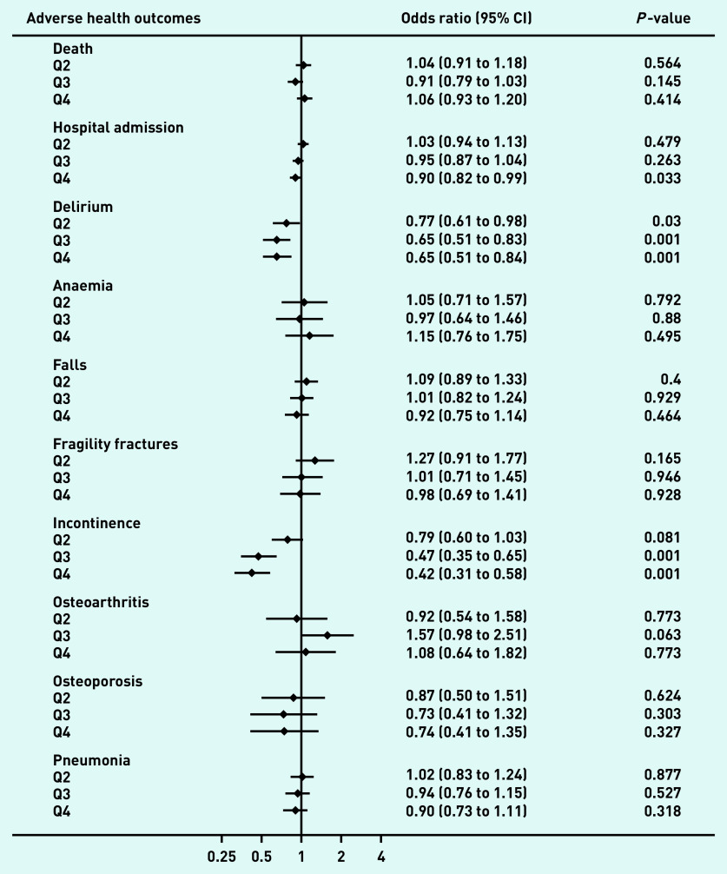
Delgado J, Evans PH, Pereira Gray D, Sidaway-Lee K, Allan L, Clare L, Ballard C, Masoli J, Valderas JM, Melzer D. Continuity of GP care for patients with dementia: impact on prescribing and the health of patients. Br J Gen Pract. 2022;72(715):e91-e98.

Slide 4
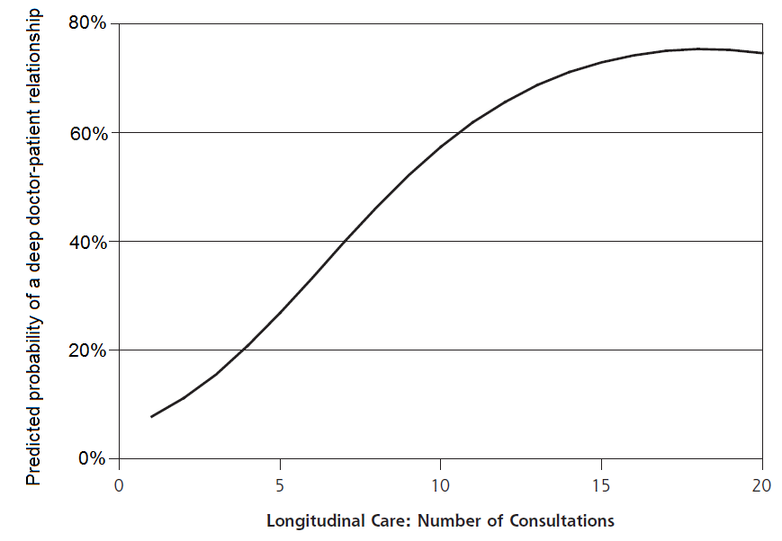
Patients may change with continuity
(modified by SLRP- vertical axis clarified and dotted lines added)
Source: Ridd MJ, Lewis G, Peters TJ, Salisbury C. Patient-Doctor Relationship Scale: Development and Validation. Ann Fam Med 2011; 9 (6): 538-545.

Slide 5
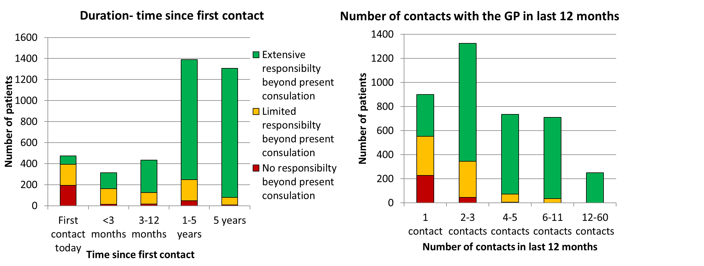
Doctors may change with continuity
Derived from: Hjortdahl P. Continuity of care: general practitioners' knowledge about, and sense of responsibility toward their patients. Family Practice. 1992;9(1):3-8.

Slide 6
Advantages for GPs of greater continuity of care.
Advantage | Additional details | References
1. Accumulated knowledge | With continuity, GPs gain more accumulated knowledge of their patients and use it for the patient’s benefit | Hjortdahl & Borchgrevink (1991) Hjortdahl (1992)
2. GP satisfaction | Personal knowledge of the patient and the doctor–patient relationship and personal continuity enable GPs to provide ‘higher-quality care’ | Ridd et al. (2006)
3. Better adherence to the doctor’s advice | Patients are easier to work with when they disclose more information, are more compliant, and when advice is followed | Chen, Tseng, Cheng (2013)
4. Efficiency in practice administration | General practices run more efficiently, when staff are clear about who is the responsible GP With personal lists queries and test results can be transmitted quickly to the patient’s responsible (personal) doctor | Pereira Gray (1979)
5. Internal professional audits | Only personal list practices can conduct internal practice audits on the care of a defined set of patients. These internal inter-doctor audits are highly educational, sustain quality improvement, with privacy for the clinicians if weaknesses are exposed | Pereira Gray (1995)
6. Forgiveness | Patients forgive some practice errors within strong patient–doctor relationships | Lings et al. (2003)
7. Reduced workload | Time to patient's next visit longer with continuity. Estimated continuity could reduce consultation demand by over 5%. | Kajaria-Montag (2022)
© St Leonard’s Practice 2022

Slide 7
Advantages for the NHS of greater continuity of care
Advantage | Additional details | References
1. Reduced A&E and out of hours use. | Patients are less likely to attend emergency departments and use out of hours provision when they have high levels of GP continuity. This has been found in several countries. | Brousseau et al 2004, van den Berg et al 2016 Takala et al 1997
2. Less overuse of medication and tests | fewer “overuse” procedures were found to be used in one study and in another, patients with dementia had fewer unnecessary or potentially harmful prescriptions. | Romano & Segal 2015 Delgado et al 2022
3. Better adherence to the doctor’s advice | Healthcare is more efficient when GPS can use accumulated knowledge to tailor prescriptions and patients trust the GP so are more likely to follow advice. | Warren et al 2015, Chen et al 2013
4. Better uptake of preventive medicine | This extends to cancer screening and vaccinations, even those which happen outside of the practice. | O’Malley et al 1997 Christakis et al 2000
5. Reduced use of hospitals | With continuity, patients are significantly less likely to be admitted to hospital. | Bankart et al 2011 Barker et al 2017 Sandvik et al 2022
6. Reduced costs | The above reductions in costs of medication, increases in preventive medicine and reductions in use of secondary care and out of hours services, all add up to reduced costs for health systems. | Bazemore et al 2018 De Maeseneer 2003
© St Leonard’s Practice 2022

Slide 8
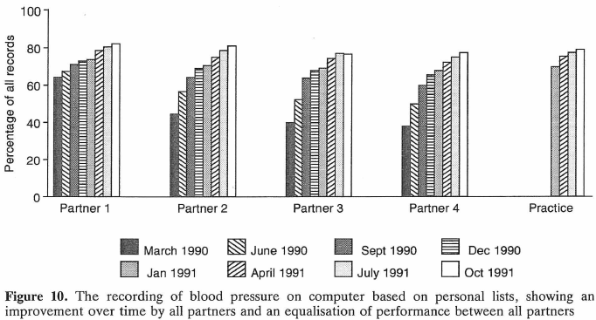
Peer group influence on working GPs mediated by personal lists
Pereira Gray D (1995) Harben lecture 1994

Slide 9
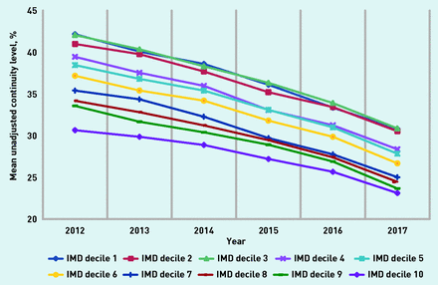
Continuity in decline
Levene et al (2018) used two questions on the national General Practice Patient Survey, related to continuity, to assess how continuity has has changed over time
Levene LS, Baker R, Walker N, Williams C, Wilson A, Bankart J. Predicting declines in perceived relationship continuity using practice deprivation scores: a longitudinal study in primary care. Br J Gen Pract. 2018; 68:e420-e426.

Slide 10
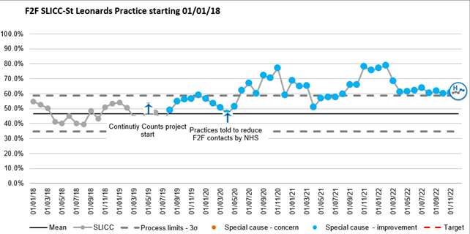
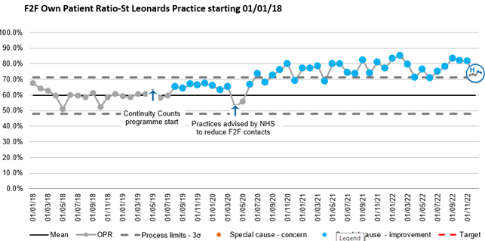

Slide 11
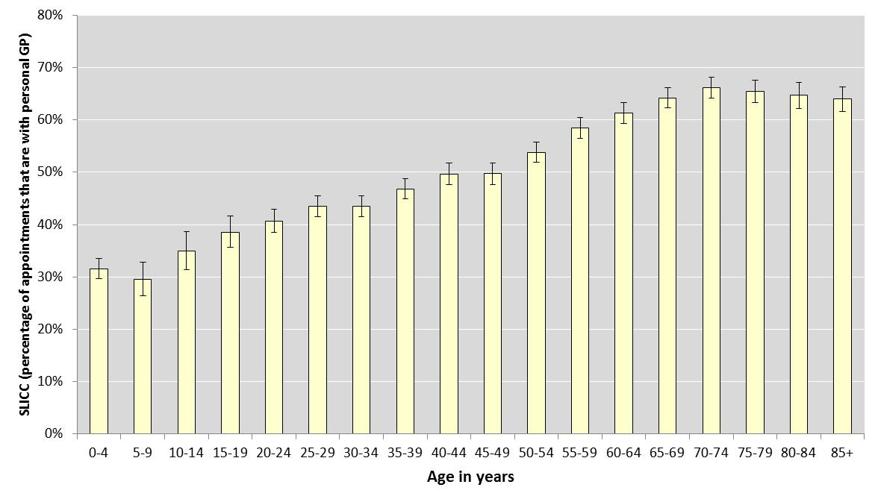
SLICC by 5 year age band 2016-2017
Error bars represent 95% Confidence Intervals
Sidaway-Lee K, Pereira Gray D, Evans P. A method for measuring continuity of care in day-to-day general practice: a quantitative analysis of appointment data. Br J Gen Pract. 2019 69 (682): e356-e362
Notes:
This shows the proportion of appointments that are with the personal dr for each of these five year age groups. Overall the mean is 51%, median 0.5. I should just say that if you take out appointments with registrars, the entire line moves up by 10 percentage points.

Slide 12
Comparison of SLICC and UPC
 | UPC | SLICC
Intended use | Continuity of care research | Regular continuity measurement in day-to-day general practice
Unit of measurement | Patient | Appointment
Specificity to personal doctor | Generally used so that the most frequent provider is the “Usual” doctor- this may be another doctor e.g. a locum or trainee. | Registered personal doctor only- this is a requirement.
Most seen GP | UPC can score a doctor as usual provider when they provide a minority of the appointments- just more than other doctors. More than one doctor can be the most-seen provider. | Gives a % of appointments that are with the personal doctor.
Range of scores | A score of 0 is impossible. Consistently higher than SLICC. | Can be 0%-100%.
Sidaway-Lee K, Pereira Gray D, Evans P. A method for measuring continuity of care in day-to-day general practice: a quantitative analysis of appointment data. Br J Gen Pract. 2019 69 (682): e356-e362
© St Leonard’s Practice 2019

Slide 13
Comparison of SLICC and UPC
 | UPC | SLICC
Timeframe | At least two and ideally more appointments required, this can take several years in relatively healthy patients. | A measure for monthly audits.
Selection bias | Includes only patients with a minimum number of appointments (usually 2) | Includes all appointments.
Ability to take into account team continuity | No, individual provider | No, individual provider
Ability to compare patient groups | Yes, although patients with few appointments are often excluded. | Yes, especially between GP lists and including infrequent attenders.
Ability to obtain scores for individual patients | Yes | No
Ease of use | Simple proportion so easy to calculate and interpret | Simple proportion/percentage so easy to calculate and interpret
Sidaway-Lee K, Pereira Gray D, Evans P. A method for measuring continuity of care in day-to-day general practice: a quantitative analysis of appointment data. Br J Gen Pract. 2019 69 (682): e356-e362
© St Leonard’s Practice 2019

